Slide 1
Continue with Layouts
We stopped after splitting the webpage into 30-70 columns.

Slide 2

Colours

Slide 3
4 ways of displaying colours
Pre-defined colours
RGB/A
Hex
HSL

Slide 4
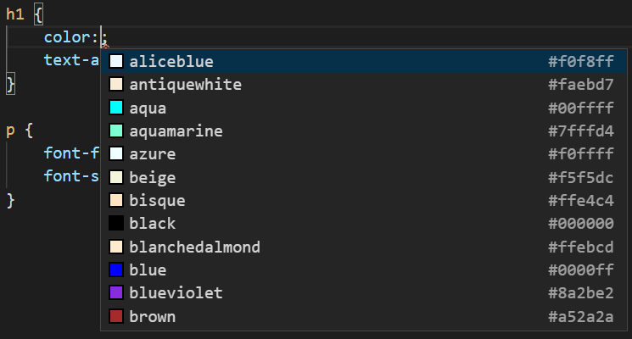
Choosing from pre-defined colours

Slide 5
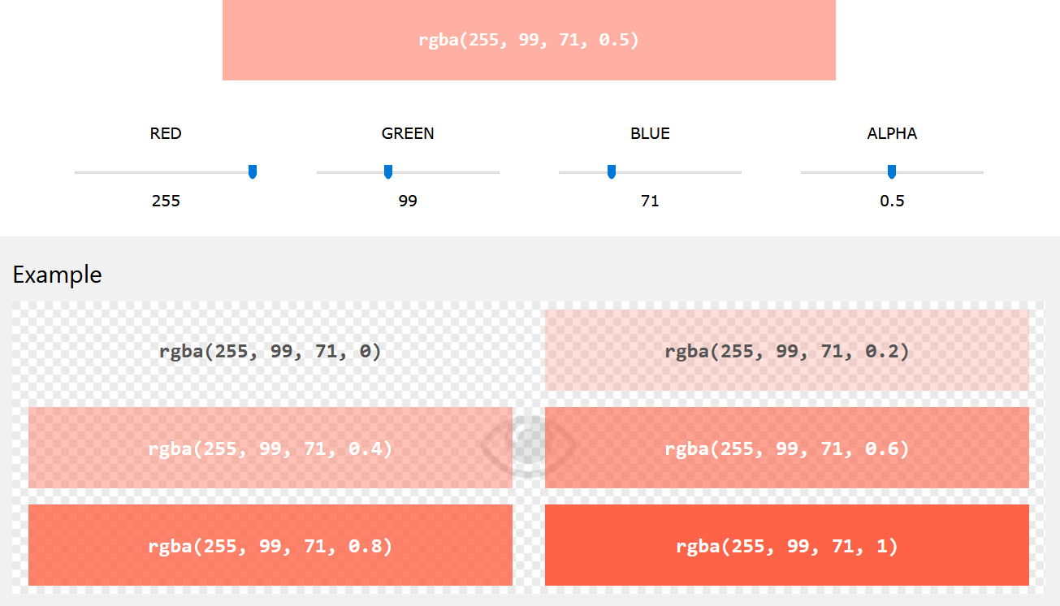
RGB-A
Red, Blue, Green, Alpha
Each value (0-255)
Alpha is 0-1 (1 being the most opaque)

Slide 6
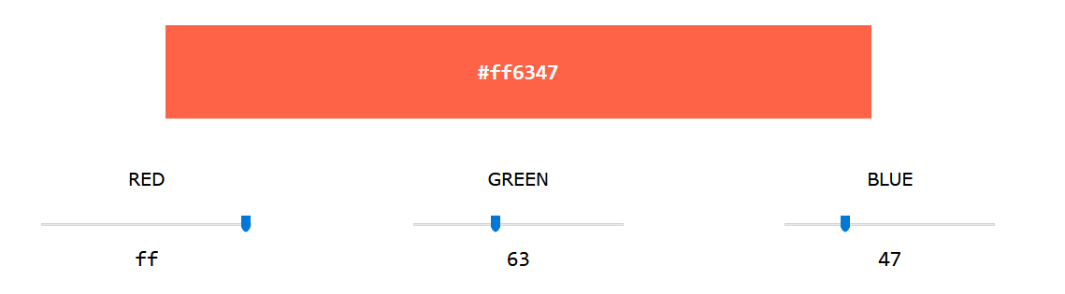
Hexadecimal
#RRGGBB
Each value ranges from 0-FF

Slide 7
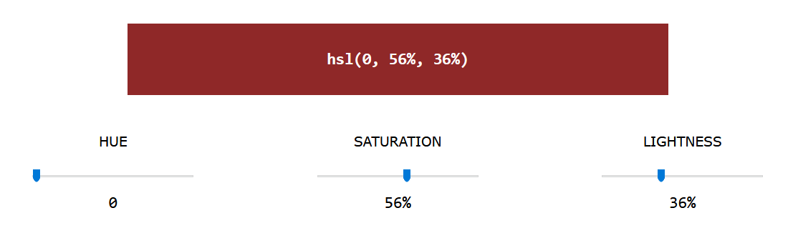
HSL
Hue: degree of colour (0-360)
0 -> red
120 -> green
240 -> blue
Saturation (0-100)
0 -> shade of grey
100 -> full colour
Lightness (0-100)
0 ->black
50 -> neutral
100 -> white

Slide 8
Task 6
Change the colours of the texts, background, etc using CSS!

